Slide 1


Slide 2

Purpose of Database Systems
View of Data
Database Languages
Relational Databases
Database Design
Transaction Management
Database Architecture
Database Users and Administrators
Overall Structure
History of Database Systems

Slide 3

DBMS contains information about a particular enterprise
  Collection of interrelated data
  Set of programs to access the data
  An environment that is both convenient and efficient to use
Database Applications:
  Banking: all transactions
  Airlines: reservations, schedules
  Universities: registration, grades
  Sales: customers, products, purchases
  Manufacturing: production, inventory, orders, supply chain
  Human resources: employee records, salaries, tax deductions
Databases touch all aspects of our lives

Slide 4

In the early days, database applications were built directly on top of file systems
Drawbacks of using file systems to store data:
  Data redundancy and inconsistency
    Multiple file formats, duplication of information in different files
  Difficulty in accessing data
    Need to write a new program to carry out each new task
  Data isolation — multiple files and formats
  Integrity problems
    Integrity constraints (e.g. account balance > 0) become “buried” in program code rather than being stated explicitly
    Hard to add new constraints or change existing ones

Slide 5

Drawbacks of using file systems (cont.)
  Atomicity of updates
    Failures may leave database in an inconsistent state with partial updates carried out
    Example: Transfer of funds from one account to another should either complete or not happen at all
  Concurrent access by multiple users
    Concurrent accessed needed for performance
    Uncontrolled concurrent accesses can lead to inconsistencies
      Example: Two people reading a balance and updating it at the same time
  Security problems
    Hard to provide user access to some, but not all, data
Database systems offer solutions to all the above problems

Slide 6

A database system is a collection of interrelated data and a set of programs to access and modify these data.
A major purpose of a database system is to provide users with an abstract view of the data. That is, the system hides certain details of how data are stored and maintained.

Slide 7

Since many database-system users are not computer trained, developers hide the complexity from users thorough several levels of abstraction, to simplify users interaction with the system.
Physical level:
  Lowest level
  describes how a record (e.g., customer) is stored.
  Complex low level data structures
Logical level:
  Next higher level.
  describes what data are stored in database, and the relationships among the data.
  type customer = record
  customer_id : string;
  customer_name : string;
  customer_street : string;
  customer_city : integer;
        end;

Slide 8


View level:
application programs hide details of data types. Views can also hide information (such as an employee’s salary) for security purposes.

Slide 9

Similar to types and variables in programming languages
Schema – The term "schema" refers to the organization of data as a blueprint of how the database is constructed
the logical structure of the database
  Example: The database consists of information about a set of customers and accounts and the relationship between them)
  Analogous to type information of a variable in a program
  Physical schema: database design at the physical level
  Logical schema: database design at the logical level
Instance – the actual content of the database at a particular point in time
  Analogous to the value of a variable

Slide 10

Physical Data Independence – the ability to modify the physical schema without changing the logical schema
Necessary to improve performance
  Applications depend on the logical schema
  In general, the interfaces between the various levels and components should be well defined so that changes in some parts do not seriously influence others.
Logical Data Independence - the ability to modify the logical schema without causing application programs to be rewritten.
  `Logical Data independence means if we add some new columns or remove some columns from table then the user view and programs should not change. For example: consider two users A & B. Both are selecting the fields "EmployeeNumber" and "EmployeeName". If user B adds a new column (e.g. salary) to his table, it will not effect the external view for user A

Slide 11

A collection of tools for describing
  Data
  Data relationships
  Data semantics
  Data constraints
Relational model : The relational model uses a collection of tables to represent both data and the relationships among those data.
Entity-Relationship data model (mainly for database design) : The E-R data model is based on a perception of a real world that consists of a collection of basic objects, called entities and of relationships among these objects.
Object-based data models (Object-oriented and Object-relational)
Semi-structured data model (XML)
Other older models:
  Network model
  Hierarchical model

Slide 12

DDL
DML

Slide 13

Language for accessing and manipulating the data organized by the appropriate data model
  DML also known as query language
Type of access are:
  Retrieval of information stored in the database
  Inserting of new information into the database
  Deletion of information from the database
  Modification of information stored in the database.
Two classes of languages
  Procedural – user specifies what data is required and how to get those data
  Declarative (nonprocedural) – user specifies what data is required without specifying how to get those data
SQL is the most widely used query language
DML OPERATIONS: INSERT, UPDATE, DELETE, MERGE

Slide 14

Specification notation for defining the database schema
  Example: create table account (
  account-number char(10),
  balance integer)
DDL compiler generates a set of tables stored in a data dictionary
Data dictionary contains metadata (i.e., data about data)
  Database schema
  Data storage and definition language
    Specifies the storage structure and access methods used
  Integrity constraints
    Domain constraints
    Referential integrity (references constraint in SQL)
    Assertions
  Authorization
DDL OPERATIONS: CREATE, ALTERM DROP, RENAME, TRUNCATE

Slide 15

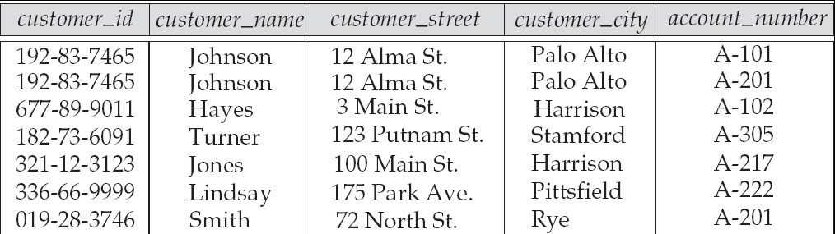
Example of tabular data in the relational model
Attributes

Slide 16



Slide 17

SQL: widely used non-procedural language
  Example: Find the name of the customer with customer-id 192-83-7465
  select customer_name
  from customer
  where customer_id = ‘192-83-7465’
  Example: Find the balances of all accounts held by the customer with customer-id 192-83-7465
  select balance
  from account
  where customer_id = ‘192-83-7465’ and
  depositor.account_number = account.account_number
Application programs generally access databases through one of
  Application program interface (e.g., ODBC/JDBC) which allow SQL queries to be sent to a database

Slide 18

The process of designing the general structure of the database:
Logical Design – Deciding on the database schema. Database design requires that we find a “good” collection of relation schemas.
  Business decision – What attributes should we record in the database?
  Computer Science decision – What relation schemas should we have and how should the attributes be distributed among the various relation schemas?
Physical Design – Deciding on the physical layout of the database

Slide 19


Models an enterprise as a collection of entities and relationships
  Entity: a “thing” or “object” in the enterprise that is distinguishable from other objects
    Described by a set of attributes
  Relationship: an association among several entities
Represented diagrammatically by an entity-relationship diagram:

Slide 20

Storage manager is a program module that provides the interface between the low-level data stored in the database and the application programs and queries submitted to the system.
In a database engine, the Storage Manager (sometimes called a Storage Engine or Storage System) is responsible for all aspects of storage, transactional requirements, low-level concurrency, and indexing.
The storage manager is responsible to the following tasks:
  Interaction with the file manager
  Efficient storing, retrieving and updating of data
Components of Storage Manager
  Authorization and integrity manager
  Transaction manager
  File manager
  Buffer manager

Slide 21

Authorization and Integrity Manager: Checks the authority of users to access data.
Transaction manager: Ensure that the database in a consistent state despite system failures, and that concurrent transaction execution proceed without conflicting.
File manager : manage allocation of space on disk storage and the data structures used to represent information stored on disk.
Buffer manager : responsible for fetching data from disk storage into main memory and decide what data to cache in main memory. The data buffer manager is a critical part of the database system, since it enables the database handle data sizes that are much larger than the size of main memory.
The buffer manager stores pages that have been deemed "important" for some reason, either because they've been recently read or because the user has configured something in the database to declare that a particular set of pages to be important (ie, a crucial index, etc).

Slide 22
The storage manager implements several data structure as part of the physical system implementation
Data files: Store the database itself.
Data dictionary : stores metadata about the structure of the database, in particular the schema of the database.
Indices: Provide first access to the data items. Like index of the textbook,

Slide 23

Users are differentiated by the way they expect to interact with the system
Application programmers –
  Computer professionals who write application programs
  Can use RAD tools for constructing forms and reports with minimal programming efforts.
Sophisticated users
  Interact with the system without writing programs.
  form requests in a database query language
  Submit query to the query processor
  Analyst

Slide 24

Specialized users –
  One type of sophisticated user
  write specialized database applications that do not fit into the traditional data processing framework (expert system, knowledge base, graphics data, audio data)
  These may be CADD systems, knowledge-based and expert systems, complex data systems (audio/video), etc
Naive users –
  invoke one of the permanent application programs that have been written previously
  Read reports
  Examples, people accessing database over the web, bank tellers,

Slide 25

Coordinates all the activities of the database system; the database administrator has a good understanding of the enterprise’s information resources and needs.
Database administrator's duties include:
  Schema definition : The DBA create the original database schema by executing a ser of data definition statements in the DDL
  Storage structure and access method definition
  Schema and physical organization modification
  Granting user authority to access the database
  Specifying integrity constraints
  Acting as liaison with users
  Monitoring performance and responding to changes in requirements

Slide 26

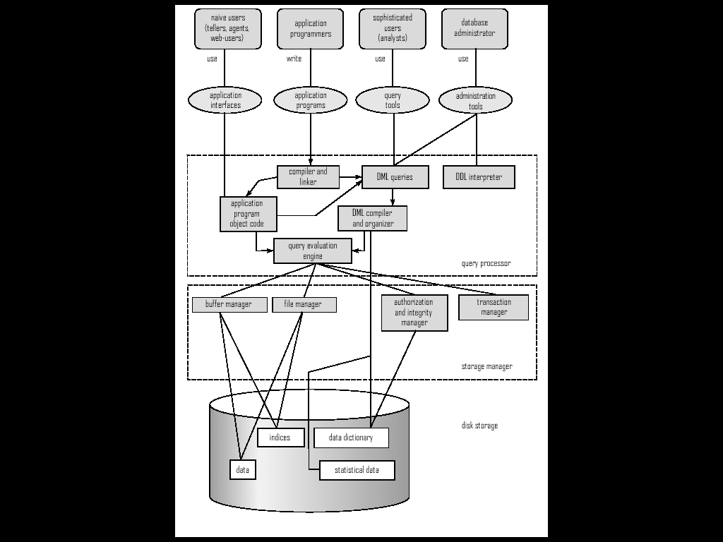

Slide 27

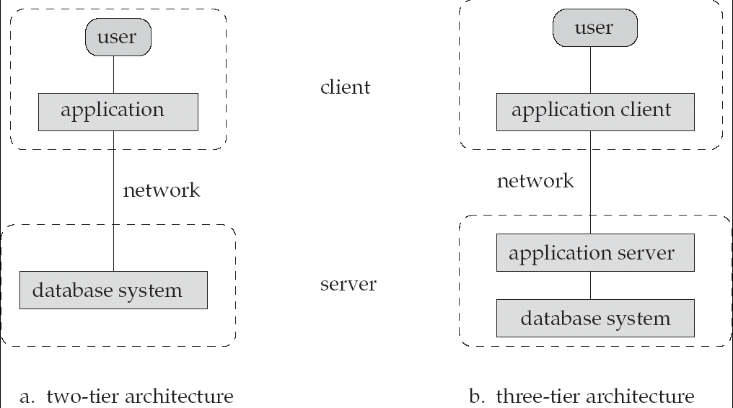

Slide 28


